Slide 1
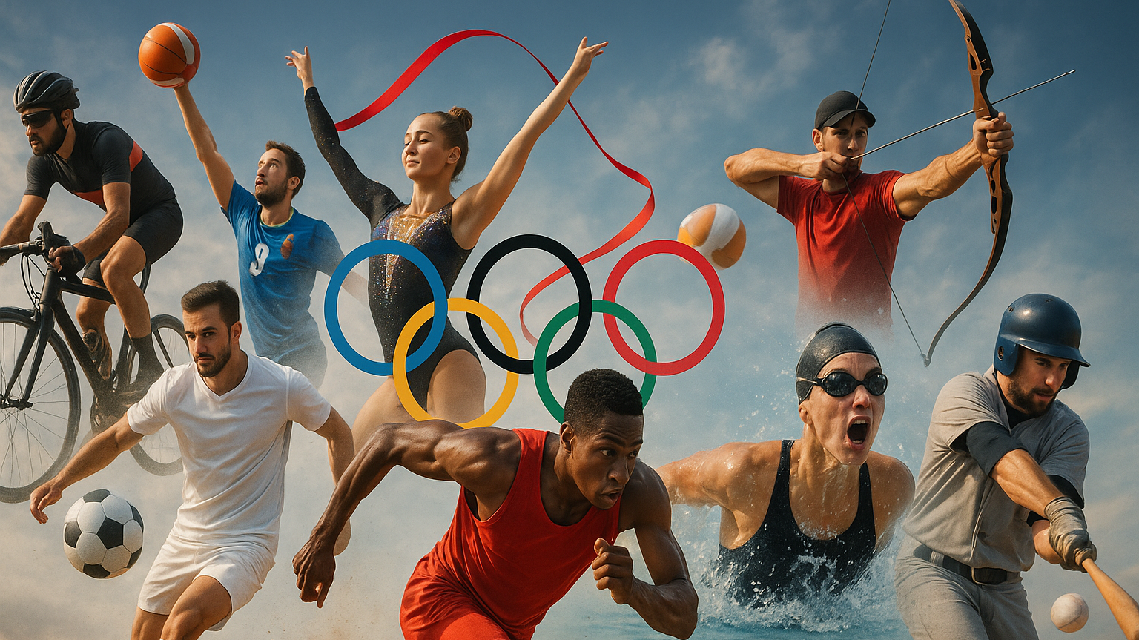
Olympic Athlete Trends: A Data Driven Look at Performance and Participation
By Tyler Austin Park

Slide 2
Why this data set? Dataset: SportStat Olympic Athletes
Chosen for its relevance to my sports advertising internship
Helps analyze athlete demographics and performance trends
Supports data-driven marketing and sponsorship decisions
Reveals which athletes stand out for targeted campaigns

Slide 3
Dataset Summary
Dataset: SportStat Olympic Athletes
Scope: Covers 1896–2016 Olympic Games
Key Features: Age, sex, height, weight, sport, event, medals, country

Slide 4
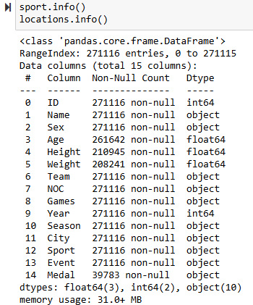
Data Inspection
Initial Inspection: When importing the dataset, I conducted a basic exploration to understand its structure:
Column names and data types
Number of rows and columns
Missing or inconsistent data
Key categorical and numerical variables

Slide 5

Guiding Questions
How has gender participation in sports changed over the years?
How does athlete participation vary by year and season?
Which countries have won the most medals, and how do medal counts trend over time?
What are the average age, height, and weight characteristics of athletes across different sports?
Which sports attract younger athletes versus older athletes?
How can these trends and patterns guide decisions in training, marketing, and event management?

Slide 6
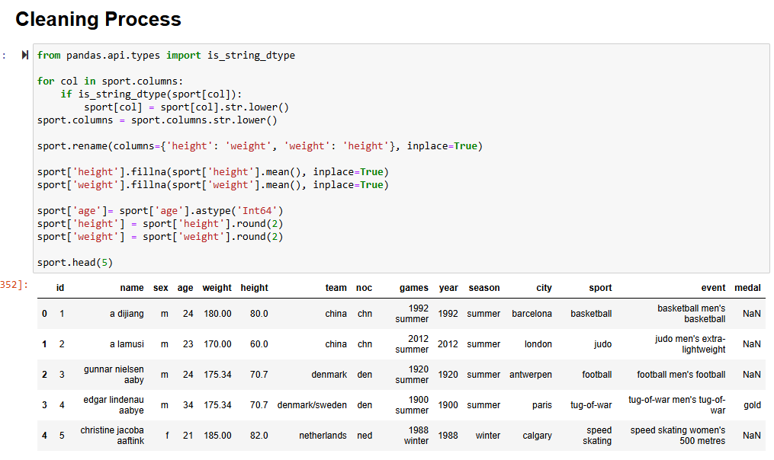
Data Cleaning
Standardized Text Columns Converted text fields like name, sport, and team to lowercase to ensure consistent results when filtering or grouping data.
Handled Missing Values Filled in missing height and weight using the mean or median, depending on the data distribution. Left the medal column unchanged, since missing values usually mean no medal was won.
Removed Duplicates Cleaned the dataset by removing repeated entries to maintain data quality and accuracy.
Converted Data Types Ensured columns like age and year were in the correct numeric format for reliable analysis.

Slide 7
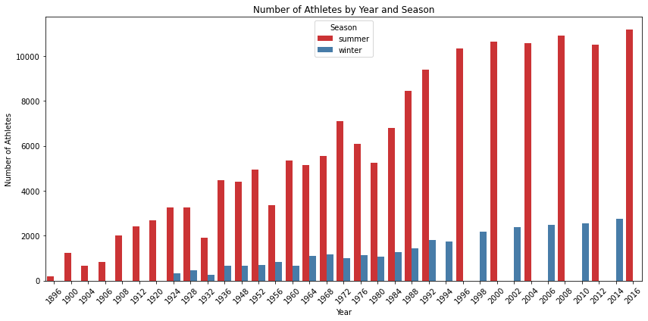
Participation Trends
Why I Analyzed Athlete Participation by Year and Season
To see how athlete turnout has changed over time
Helps identify growth patterns in both Summer and Winter Olympics
Useful for understanding which years had higher engagement
Highlights the scale and popularity of each Olympic season
Can support planning around peak years or seasons for campaigns

Slide 8
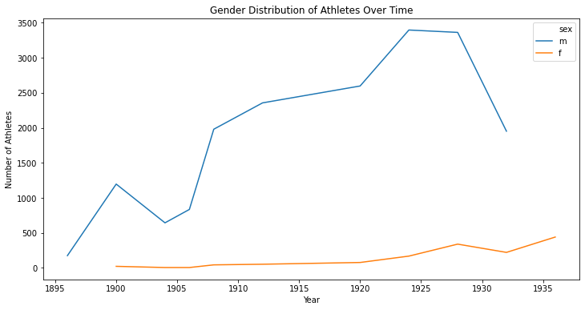
Gender Distribution Over Time
Why I Analyzed Gender Distribution Over Time
To track how male and female athlete participation has changed
Helps show progress in gender representation across Olympic history
Useful for identifying trends in inclusivity and sport access
Supports campaigns that focus on equity and representation
Insights can guide sponsorship and audience targeting decisions

Slide 9
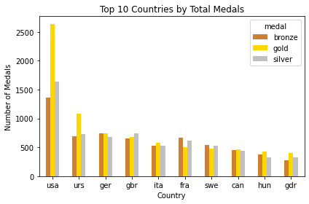
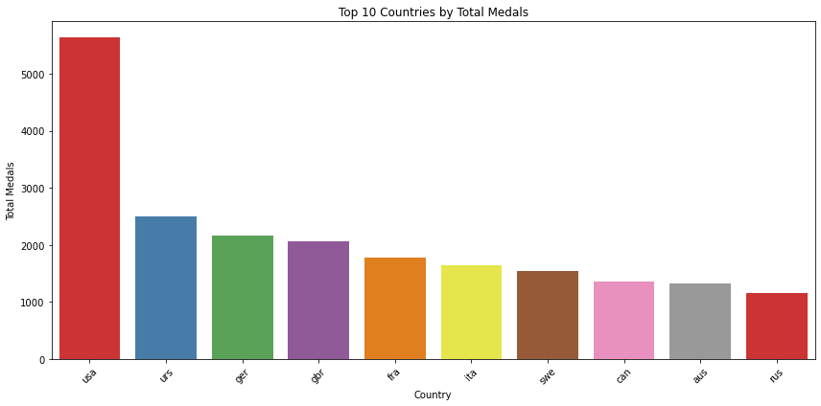
Medal Trends
Why I Analyzed Medal Trends
To understand which countries consistently perform well in the Olympics
Helps highlight global competition and dominance in certain sports
Useful for spotting long-term success or emerging nations in sports
Can guide sponsorship strategies based on medal performance
Shows how athletic success is spread across the world over time

Slide 10
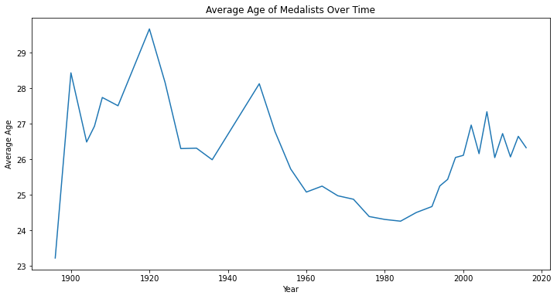
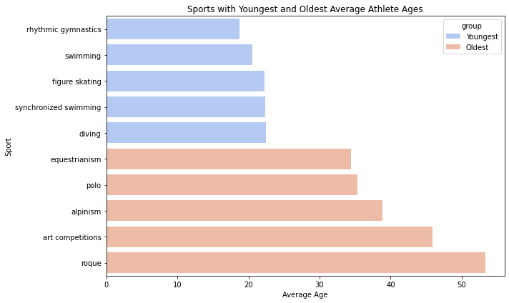
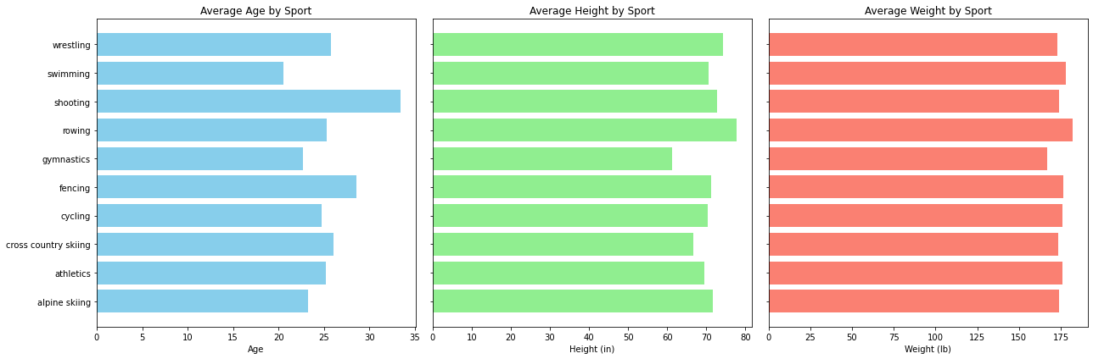
Age, Height & Weight Analysis
Why I Analyzed Age, Height & Weight
To understand the typical physical profiles for athletes in different sports
Helps identify what age groups succeed in which types of events
Useful for spotting patterns (e.g., taller athletes in basketball, lighter ones in gymnastics)
Can support marketing or sponsorship decisions based on athlete demographics
Gives insight into how body type and age relate to Olympic success

Slide 11
Key Insights for Advertising
Target Audience Identification Use age, gender, and sport preferences to tailor ads to specific groups.
Seasonal Campaigns Focus advertising around Summer or Winter Olympics based on athlete participation trends.
Gender-Specific Marketing Adjust messaging based on the growing participation of female athletes over time.
Country-Specific Strategies Prioritize countries with high medal counts or athlete representation for localized campaigns.
Athlete Profiles Leverage data on average age, height, and weight to feature relatable athlete stories.
Trends Over Time Use historical trends to predict and plan future advertising opportunities.

Slide 12
Challenges & Limitations
Incomplete or Missing Data Some athlete information like age, height, or weight may be missing or inaccurate.
Data Quality Issues Inconsistencies in how data was recorded across different years or sources.
Limited Context The dataset does not capture qualitative factors such as athlete injuries or training conditions.
Simplified Metrics Using averages can mask important variations within sports or athlete groups.
Changing Event Formats Olympic events and participation rules have evolved, making direct comparisons over time tricky.
Representation Bias Some countries or sports may be underrepresented, skewing analysis results.

Slide 13
What I Learned for the Future
Turning raw data into strategy:
I learned how to translate complex datasets into clear insights that support real-world decision-making; a critical skill for marketing, analytics, and consulting roles.
Working with messy, real-world data
This project strengthened my ability to clean and prepare data. From handling missing values to standardizing formats. Which is essential in nearly any data-driven job.
Asking the right questions
I learned how to frame and refine analytical questions to stay focused and make the analysis more valuable and actionable.
Communicating with impact
Building visuals and structuring findings for non-technical audiences helped me practice simplifying complex insights — an essential skill in client-facing and team roles.
Connecting data to business goals
The internship context showed me how data can inform sponsorship, advertising, and brand strategy — and how technical work fits into bigger business decisions.

Slide 14

Summary of Findings
Male athletes have consistently outnumbered female athletes, but female participation has steadily increased over time
The total number of athletes varies by year and season, reflecting changes in the scale of sporting events
Certain countries dominate medal counts, indicating strong sports programs and investment
Different sports attract athletes of varying average age, height, and weight, showing the physical demands unique to each sport
Younger athletes tend to participate in some sports while others have older average participants
These insights can inform training programs, marketing strategies, and event planning for better engagement and performance

